Slide 1
How fast can we sort?
x[1] ≤ x[2]
T
F
x[2] ≤ x[3]
x[1] ≤ x[3]
T
F
T
F
X[1] x[2] x[3]
x[1] ≤ x[3]
X[2] x[1] x[3]
x[2] ≤ x[3]
T
F
T
F
X[1] x[3] x[2]
X[3] x[1] x[2]
X[2] x[3] x[1]
X[3] x[2] x[1]
Decision Tree

Slide 2
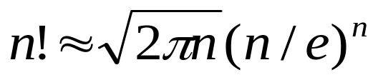
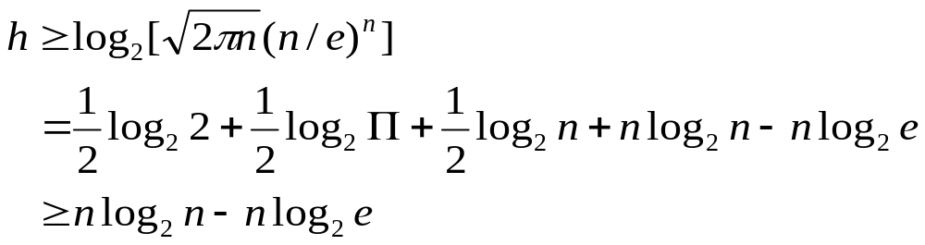
How fast can we sort?
If we have to sort n numbers, we have seen thatthe height of the decision tree, h, must be h≥ log₂ (n!)
Stirling’s Approximation:
Therefore, h_{smallest} = n log₂n - n log₂e

Slide 3
How many binary trees can you draw with n nodes?
n=1: b₁=1
n=2: b₂=2
n=3: b₃=5

Slide 4
How many binary trees can you draw with n nodes?
n=4 b₄=14

Slide 5
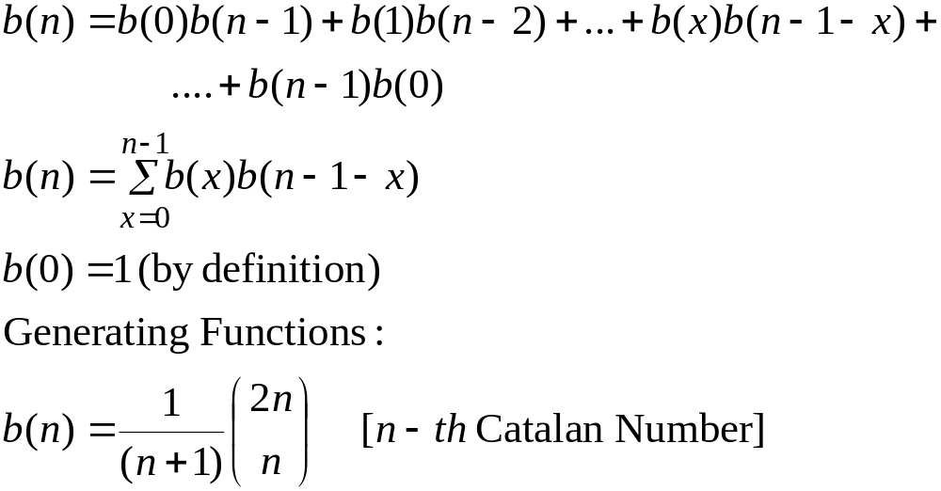
How many binary trees can you draw with n nodes?
Suppose b(n) is the number of binary trees that can be constructed with n nodes. In that case, b(n) can be expressed with the following recurrence relation

Slide 6
Dynamic Programming
A very useful algorithm design technique
Explanation through example
Matrix Chain Multiplication Problem

Slide 8
Matrix Chain Multiplication Problem
What is the fewest number of multiplications necessary to compute product of a matrix chain?
M₁* M₂* M₃* … * M_{i} * … * M_{k}* M_{k+1}* … * M_{j} * … * M_{n}
Does the order in which the matrices are multiplied matter?
Suppose we need to compute M₁* M₂* M₃ where the dimensions of the matrices are 20×50, 50×1, and 1×100 respectively.

Slide 10
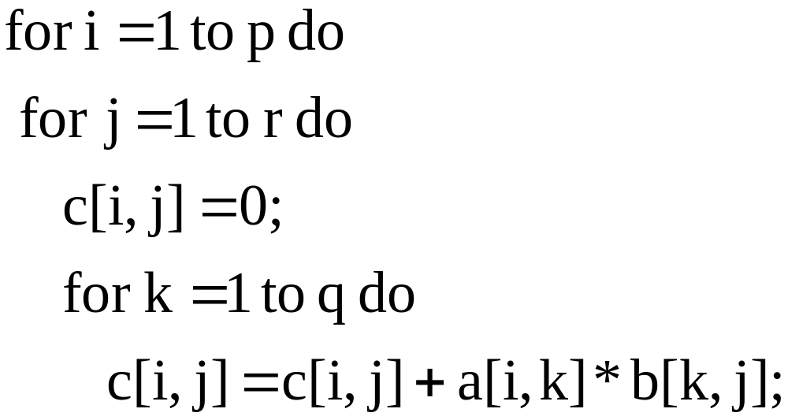
Algorithm for Matrix Multiplication
A is a p×q matrix and B is a q×r matrix
No. of multiplications = p*q*r

Slide 12
Suppose we need to compute M₁* M₂* M₃ where the dimensions of the matrices are 20×50, 50×1, and 1×100 respectively
In this example, we have two options for multiplication,
(M₁* M₂)* M₃ or M₁* (M₂* M₃)
If we take the first option, the number of multiplications needed will be 20×50×1 + 20×1×100 = 3000
If we take the second option, the number of multiplications needed will be 50×1×100 + 20×50×100 = 105000
The order in which the matrices are multiplied is very important in determining the computational time of the algorithm

Slide 14
Matrix Chain Multiplication
M₁* M₂* M₃* … * M_{i} * … * M_{k}* M_{k+1}* … * M_{j} * … * M_{n}
(i-1)*k k*j
M_{i} * … * M_{k}* M_{k+1}* … * M_{j}
Dimension of M_{i} ➔ p_{i-1} x p_{i}
m[ i , j ] = optimal number of multiplications necessary to
multiply matrices M_{i} through M_{j}
= m[ i , k ] + m[ k+1 , j ] + p_{i-1} . p_{k} . p_{j}
0, if i=j
m[ i , j ] =
min [m[ i , k ] + m[ k+1 , j ] + p_{i-1} . p_{k} . p_{j} ]
_{i ≤ k ≤ j}

Slide 16
Matrix Chain Multiplication
M = M₁ * M₂ * M₃ * M₄
(10x20) (20x50) (50x1) (1x100)
4
1
j
3
i
2
2
3
1
4

Slide 18
Dynamic Programming
Characterize the structure of an optimal solution
Recursively define the value of an optimal solution
Compute the value of an optimal solution in a bottom-up fashion
Construct the optimal solution from computed information
A problem is said to exhibit “optimal substructure” if an optimal solution to the problem contains within it optimal solution to sub-problems
Whenever a problem exhibits optimal substructure, it is a good clue that dynamic programming might apply.

Slide 19
Optimal Polygon Triangulation
Polygon : A piecewise linear closed curve in the plane

Slide 20
Simple Polygon
The polygon that does not cross itself.

Slide 21
Convex Polygon
Given any 2 points on its boundary or in its interior, all points on the line segment drawn between them are contained in the polygon’s boundary or interior.

Slide 22
A Triangulation of the Polygon
v₀
v₆
w₂
v₁
v₅
w₃
w₄
w₅
v₂
w₁
v₃
v₄

Slide 23
A Different Triangulation of the Polygon
v₀
v₆
v₁
X₃
X₂
v₅
X₄
v₂
X₅
X₁
v₃
v₄

Slide 24
Triangulation of a Polygon
It is a set of chords of the polygon that divide the polygon into disjoint triangles (polygons with 3 sides)
Consider two non-adjacent vertices v_{i} and v_{j} of the polygon. The segment v_{i} v_{j} is a chord of the polygon.
With each triangle we associate a weight:
  Area of the triangle
  Sum of the length of the chords

Slide 25
Optimal Polygon Triangulation Problem
Given a convex polygon P = < v₀, v₁, …, v_{n-1}> and a weight function w defined on the triangles formed by the sides and chords of P, find a triangulation that minimizes the sum of the weights of the triangles in the traingulation.

Slide 26
Optimal Triangulation of an (n+1) vertex polygon
P = <v₀, v₁, …, v_{n}>
<v₀, v₁, …, v_{i-1}, v_{i}, v_{i+1}, …, v_{k}, v_{k+1}, …, v_{n}>
<v₀, v₁, …, v_{i-1}, v_{i}, v_{i+1}, …, v_{k}, v_{k+1}, …, v_{j}, v_{j+1}, …, v_{n}>
Consider optimal triangulation of the polygon <v_{i-1}, …, v_{j}>
t[i,j] = weight of an optimal triangulation of the polygon
<v_{i-1}, v_{i}, …, v_{j}>

Slide 27
Optimal Triangulation of Polygon
v_{n}
v₀
v_{j}
P = <v₀, v₁, …, v_{n}>
<v₀, v₁, …, v_{i-1}, v_{i}, v_{i+1}, …, v_{k}, v_{k+1}, …, v_{n}>
<v₀, v₁, …, v_{i-1}, v_{i}, v_{i+1}, …, v_{k}, v_{k+1}, …, v_{j}, v_{j+1}, …, v_{n}>
Consider optimal triangulation of the polygon <v_{i-1}, …, v_{j}>
t[i,j] = weight of an optimal triangulation of the polygon
<v_{i-1}, v_{i}, …, v_{j}>
v_{i-1}
v_{k}

Slide 28
Optimal Polygon Triangulation
For a fixed k,
t[i, j] = t[i, k] + t[k+1, j] + w(v_{i-1}v_{k}v_{j})
0, if i=j
t[i, j] =
min [t[i, k] + t[k+1, j] + w(v_{i-1}v_{k}v_{j})]
i ≤ k ≤ j-1

Slide 29
Longest Common Subsequence Problem
Given a sequence X = <x₁, x₂, …, x_{m}>, another sequence Z = <z₁, z₂, …, z_{k}>,
is a subsequence of X if there exists a strictly increasing sequence < i₁, i₂, …, i_{k}> of indices of X such that for all j=1, 2, …, k, we have x_{ij}= z_{j}.
Ex: X = <A, B, C, B, D, A, B>
Z = <B, C, D, B>
index sequence = <2, 3, 5, 7>

Slide 30
A sequence Z is a common subsequence of X and Y if Z is a subsequence of both X and Y.
Longest Common Subsequence Problem
Given two sequences X = < x₁, x₂, …, x_{m}> and
Y = < y₁, y₂, …, y_{n}>, find a maximum length subsequence of X and Y.
Example:
X ➔ A B C B D A B, m=7
Y ➔ B D C A B A, n=6 LCS ➔ B C A B
Given a sequence X = < x₁, x₂, …, x_{m}> we define the i-th prefix of X, (0≤ i ≤ m) as
X_{i} = < x₁, x₂, …, x_{i}> (X₀ is the empty sequence)

Slide 31
X_{m} = <x₁, x₂, …, x_{m}>
Y_{n} = <y₁, y₂, …, y_{n}>
Z_{k} = <z₁, z₂, …, z_{k}> ⬅ LCS of X and Y
Case I
If x_{m} = y_{n} then, z_{k} = x_{m} = y_{n}
Z_{k-1} must be a LCS of X_{m-1} and Y_{n-1.}

Slide 32
X_{m} = <x₁, x₂, …, x_{m}>
Y_{n} = <y₁, y₂, …, y_{n}>
Z_{k} = <z₁, z₂, …, z_{k}> ⬅ LCS of X and Y
Case II
If x_{m} ≠ y_{n} and z_{k} ≠ x_{m} ,
then Z_{k} is a LCS of X_{m-1} and Y_{n}

Slide 33
X_{m} = <x₁, x₂, …, x_{m}>
Y_{n} = <y₁, y₂, …, y_{n}>
Z_{k} = <z₁, z₂, …, z_{k}> ⬅ LCS of X and Y
Case III
If x_{m} ≠ y_{n} and z_{k} ≠ y_{n} ,
then Z_{k} is a LCS of X_{m} and Y_{n-1}

Slide 34
X = <x₁ …. x_{m}>
X_{i} = <x₁ …. x_{i}>
Y = <y₁ …. y_{n}>
Y_{j} = <y₁ …. y_{j}>
C[i, j] = length of the LCS of X_{i} and Y_{j}
C[i-1, j-1] + 1 , if x_{i} = y_{j,} (i,j>0)
C[i, j] = max [C[i, j-1], C[i-1, j]], if x_{i} ≠ y_{j}(i,j>0)
0 , if i=0 or j=0

Slide 35
LCS_LENGTH (X, Y)
m ← Length (X)
n ← Length (Y)
for i ← 1 to m do c[i, 0] ← 0
for j ← 1 to n do c[0, j] ← 0
for i ← 1 to m do
for j ← 1 to n do
if x_{i} = y_{j} then
c[i, j] ← c[i-1, j-1] + 1
b[i, j] ← ‘ ’
else if c[i-1, j] ≥ c[i, j-1] then
c[i, j] ← c[i-1, j]
b[i, j] ← ‘ ’
else
c[i, j] ← c[i, j-1]
b[i, j] ← ‘ ’
return c and b

Slide 36
Example of an LCS
j
0
1
2
3
4
5
6
i
y_{j}
B
D
C
A
B
A
0
x_{i}
0 | 0 | 0 | 0 | 0 | 0 | 0
0 | 0 | 0 | 0 | 1 | 1 | 1
0 | 1 | 1 | 1 | 1 | 2 | 2
0 | 1 | 1 | 2 | 2 | 2 | 2
0 | 1 | 1 | 2 | 2 | 3 | 3
0 | 1 | 2 | 2 | 2 | 3 | 3
0 | 1 | 2 | 2 | 3 | 3 | 4
0 | 1 | 2 | 2 | 3 | 4 | 4
1
A
2
B
3
C
4
B
5
D
6
A
7
B

Slide 37
Optimal Binary Search Tree
(Ref: Data Structures by Reingold)
Problem
Given -
  A set of keys
  Frequencies of successful search
  Frequencies of unsuccessful search
  Construct an Optimal Binary Search Tree

Slide 38
Binary Search Tree
A non-empty binary search tree satisfies the following
properties:
Every element (node) has a distinct key.
The keys (if any) in the left subtree are smaller than the key in the root.
The keys (if any) in the right subtree are larger than the key in the root.
The left and right subtrees are also binary search trees.

Slide 39
Binary Search Tree
Keys : A E I O U
Frequency of successful search : β_{i}
Frequency of unsuccessful search : α_{i}
E
A
O
E
E
U
A
O
I
A
I
I
U
O
U

Slide 40
O
32
42
E
U
12
32
A
26
I
95
21
0
34
38
58
W(T) = 32*3 + 42*2 + 32*1 + 26*3 + 12*2+
0*3 + 34*3 + 38*3 + 58*3 + 95*2 + 21*2
= 314 + 622 = 936
W(T_{l}) = 32*2 + 42*1 + 26*2 + 0*2 + 34*2 + 38*2 + 58*2
W(T_{r}) = 12*1 + 95*1 + 21*1

Slide 41
Optimal Binary Search Tree
A Binary Search Tree that requires the fewest number of comparisons is known as the Optimal Binary Search Tree
Strategy
  Put the node with highest frequency as the root.
Example: Keys A E
Freq. of successful search : β₁ β₂
Freq. of unsuccessful search : α₀ α₁ α₂

Slide 42
K₁=A, K₂ =E; β₁ =10, β₂ =5; α₀ =2, α₁ =4, α₂ =8
Total Comparison =
10*1 + 5*2 + α₀ * 1 + α₁ * 2 + α₂ * 2
= 20 + 2 + 8 +16
= 46
Total Comparison =
5*1 + 10*2 + α₀ * 2 + α₁ * 2 + α₂ * 1
= 25 + 4 + 8 +8
= 45
K₁
10
5
K₂
α₀
α₂
K₂
5
10
K₁
α₁
α₂
α₀
α₁

Slide 43
O
32
42
E
U
12
32
A
26
I
95
21
0
34
38
58
W(T) = 32*3 + 42*2 + 32*1 + 26*3 + 12*2+
0*3 + 34*3 + 38*3 + 58*3 + 95*2 + 21*2
= 314 + 622 = 936
W(T_{l}) = 32*2 + 42*1 + 26*2 + 0*2 + 34*2 + 38*2 + 58*2
W(T_{r}) = 12*1 + 95*1 + 21*1

Slide 44
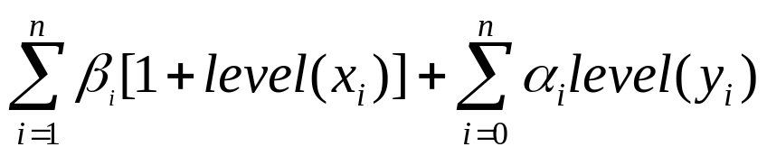
W(T) = W(T_{l}) + W(T_{r}) + Σα_{i} + Σβ_{j}
α₀ β₁ α₁ β₂ … α_{i} β_{i+1} … β_{j} α_{j} … β_{n} α_{n}
C_{ij} = Cost of the optimal binary search tree over the frequencies
α_{i} β_{i+1} … β_{j} α_{j} and C_{ii} = 0
Total Comparisons =
Principle of Optimality: An Optimal Binary Search Tree over the frequencies
α₀ β₁ α₁… β_{i-1} α_{i-1} β_{i} α_{i+1} … β_{n} α_{n}
K₁ K_{i-1} K_{i} K_{n}
and rooted at K_{i} cannot be constructed unless the left sub-tree over the
frequencies α₀ β₁ α₁… β_{i-1} α_{i-1} is an Optimal Binary Search Tree and the right
sub-tree over the frequencies α _{i+1} … β_{n} α_{n} is an Optimal Binary Search Tree

Slide 45
C_{ij} = cost of the optimal tree over the frequencies α_{i} , β_{i+1} , … , β_{j} , α_{j}
α₀ β₁ α₁ … … β_{n}
K_{i+1} K_{k} K_{j}
R_{ij} = a value of k that minimizes (C_{i, k-1} + C_{k, j} )
α_{i} β_{i+1}α_{i+1} ….. α_{j-1} β_{j} α_{j}
α_{i} β_{i+1}α_{i+1} …. β _{k-1} α _{k-1} β_{k} α_{k} …. α_{j-1} β_{j} α_{j}

Slide 46
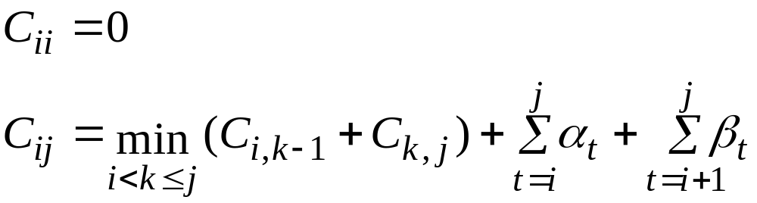
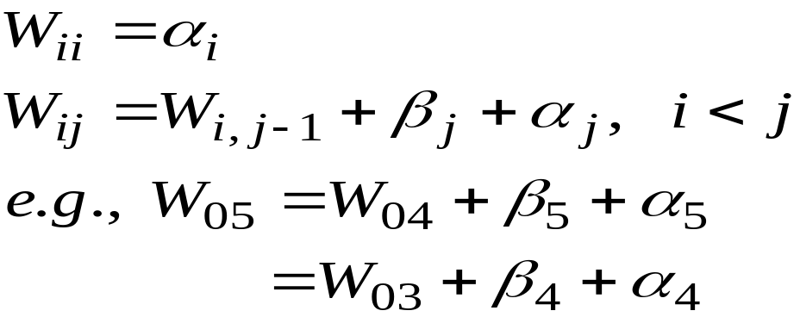
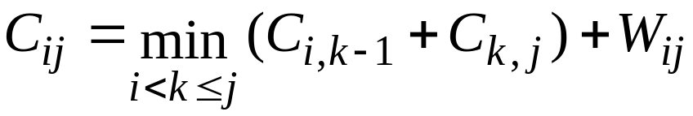

Slide 47
R₀₅ = 4
W₀₅ = 390
C₀₅ = 936
5
0
j
4
i
1
3
2
2
3
1
4
0
5
R₀₀ = 0
W₀₀ = 0
C₀₀ = 0
R₁₁ = 0
W₁₁ = 34
C₁₁ = 0
R₂₂ = 0
W₂₂ = 38
C₂₂ = 0
R₃₃ = 0
W₃₃ = 58
C₃₃ = 0
R₄₄ = 0
W₄₄ = 95
C₄₄ = 0
R₅₅ = 0
W₅₅ = 21
C₅₅ = 0

Slide 48
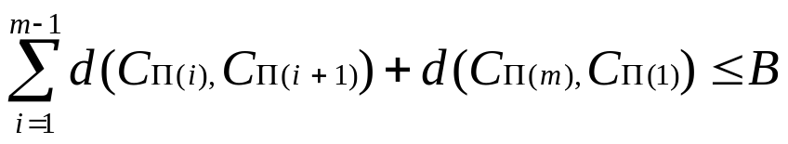
Traveling Salesman Problem
(Ref: Algorithmics by Brassard and Bratley)
Instance: A finite set C={c₁, c₂, …, c_{m}} of cities, a distance d(c_{i}, c_{j}) є Z⁺ for each pair of cities c_{i}, c_{j} є C and a bound B є Z⁺ (where Z⁺ denotes the positive integers).
Question: Is there a tour of all cities in C having total length no more than B, that is an ordering <c_{π(1)}, c_{π(2)}, …, c_{π(m)}> of C such that,

Slide 49
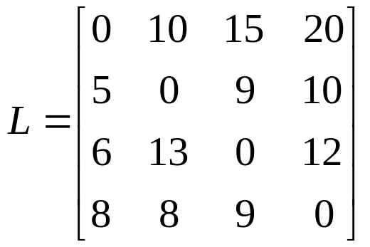
Traveling Salesman Problem
Example: Let G be the following complete graph on four nodes:
10
1
2
5
8
20
8
6
9
10
15
13
4
12
3
9

Slide 50

Traveling Salesman Problem
G = (V, A) ← Directed graph
V = { 1, 2, …, n }
L_{ij} = Length of the edge between nodes i and j
L_{ii} = 0
L_{ij} = ∞, if the edge (i, j) does not exist.
S V – {1}
i Є V – S, with i=1 allowed only if S = V – {1}
g(i, S) = length of the shortest path from node i to node 1 that passes exactly once through each node of S.

Slide 51
Traveling Salesman Problem
g(i, S) = length of the shortest path from node i to node 1 that passes exactly once through each node of S.
S
i
j
1

Slide 52
g(i, S) = length of the shortest path from node i to node 1 that passes exactly once through each node of S.
g(1, V – {1}) = length of the optimal tour
g(1, V – {1}) = (L_{1j} + g(j, V – {1,j}))
S
i
j
1

Slide 53
Traveling Salesman Problem
g(1, V – {1}) = length of the optimal tour
g(1, V – {1}) = min_{2≤j≤n} (L_{1j} + g(j, V – {1,j}))
More generally,
if i ≠1, S ≠ Ø, S ≠ V – {1} and i not in S,
g(i, S) = min_{jЄS} (L_{ij} + g(j, S – {j}))
g(i, Ø) = L_{i1}, i = 1, 2, …, n

Slide 54
Travelling Salesman Problem
Example: Let G be the following complete graph on four nodes:
We initialize, g(2, Ø) =5, g(3, Ø) =6, g(4, Ø) =8.
10
1
2
5
8
20
8
6
9
10
15
13
4
12
3
9

Slide 55
g(2,{3}) = L₂₃ + g(3,Ø) = 15
g(2,{4}) = L₂₄ + g(4,Ø) = 18
and, similarly
g(3,{2}) = 18, g(3,{4}) = 20
g(4,{2}) = 13, g(4,{3}) = 15
Next, using set of two nodes:
g(2,{3,4}) = min (L₂₃ + g(3,{4}), L₂₄ + g(4,{3}))
= min (29, 25) =25
g(3,{2,4}) = min (L₃₂ + g(2,{4}), L₃₄ + g(4,{2}))
= min (31, 25) =25
g(4,{2,3}) = min (L₄₂ + g(2,{3}), L₄₃ + g(3,{2}))
= min (23, 27) =23
Finally,
g(1, {2,3,4})= min(L₁₂+g(2,{3,4}), L₁₃+g(3,{2,4}), L₁₄+g(4,{2,3}))
= min (35, 40, 43) = 35

Slide 56
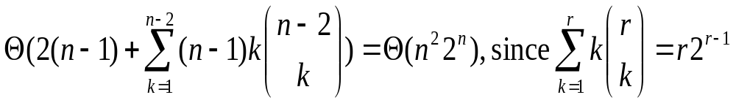
The required computation time can be calculated as follows:
to calculate g(j,Ø): n-1 consultations of a table;
to calculate all the g(i,S) such that 1≤#S=k≤n-2:
(n-1) ^{n-2}C_{k} k additions in all;
to calculate g(1,N-{1}): n-1 additions
The computation time is:
TABLE : Solving the Traveling Salesperson Problem
n | Time: Direct Method n! | Time: Dynamic Prog. n²2^{n} | Space: Dynamic Prog. n2^{n}
5 | 120 | 800 | 160
10 | 3,628,800 | 102,400 | 10,240
15 | 1.31 x 10¹² | 7,372,800 | 491,520
20 | 2.43 x 10¹⁸ | 419,430,400 | 20,971,520

